Slide 1
Leadership informed by poverty
Chad Dull
Poverty Informed Consulting

Slide 2
We all come from somewhere

Slide 3
What I would like you to learn today
Poverty is a circumstance and a context. Poverty is not a character flaw.

Slide 4
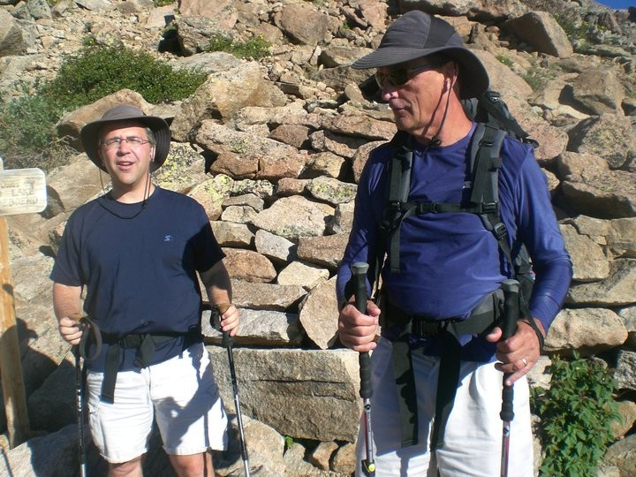
Ethics are Easy When Life is Good
ChalleNGe Academy
Les Misérables
Greg Dull

Slide 5
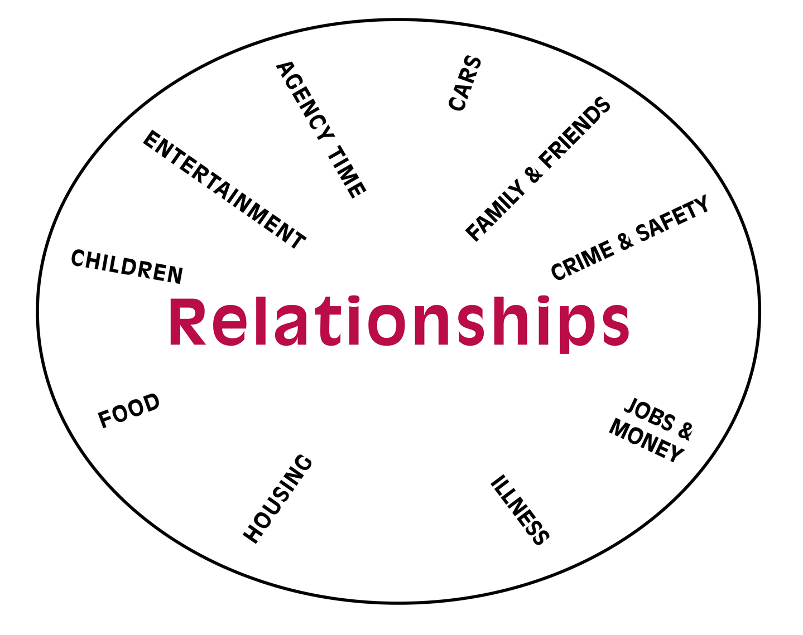
Mental Model for Poverty

Slide 6
Poverty-informed Practice Is…
A mindset that allows us to stand in awe of our students (or clients/customers/employees) who face the impacts of poverty daily and choose college anyway
A form of first choice service acknowledging the audacious courage it takes to pursue education (or employment) when even your basic needs are tenuous

Slide 7
Poverty-informed Practice Is…
A commitment to reducing barriers for students (or clients/customers/employees), so they may use their education (or other opportunity_ to change their economic reality
An intentional choice to love the students (or clients/customers/employees) you have

Slide 8
What are the elements of Poverty-Informed leadership?

Slide 9
I can’t let my body get used to eating…

Slide 10
Everything “Speaks’

Slide 11
Everything “Speaks”

Slide 12
If you are a poverty informed leader…

Slide 13
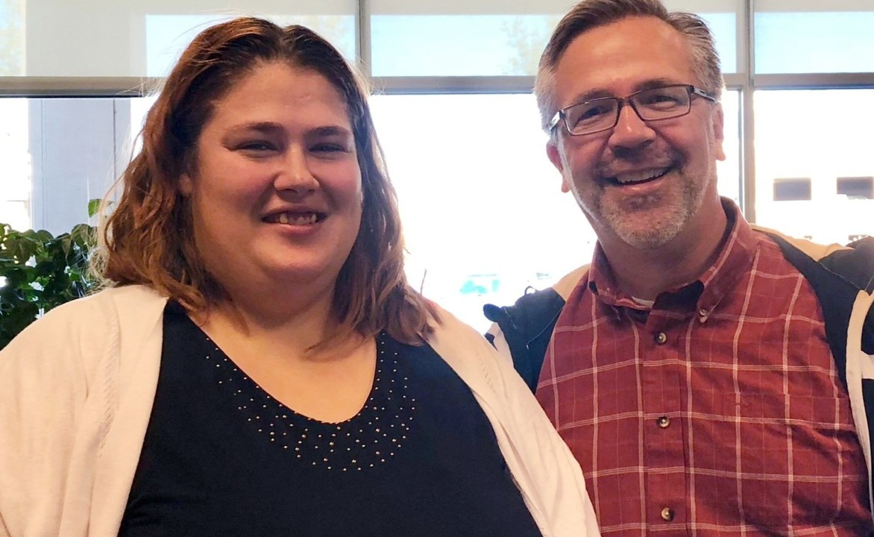
The Power of Proximity

Slide 14
Acknowledge the truth

Slide 15
You do what it takes

Slide 16
Make it easy

Slide 17
If you see something…

Slide 18
A Call to Action
1.
Default to action, default to helping
“If you see something, do something”
2.
Conduct a fearless self-inventory for bias
(aka “common sense”)
3.
Seek to connect, build relationships, and create solutions
4.
Get comfortable being uncomfortable

Slide 19
If you want to connect and grow the movement.
Twitter: @cddull
Facebook:@povertyinformedpractice
LinkedIn: Chad Dull
www.povertyinformedpractice.com

